Slide 1
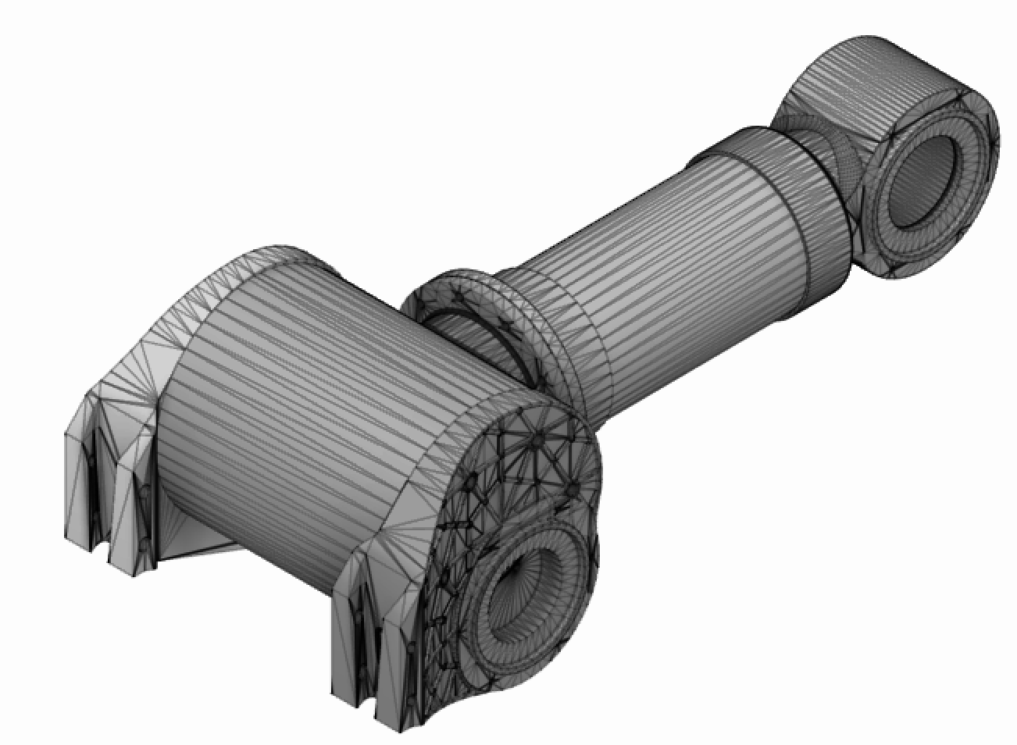
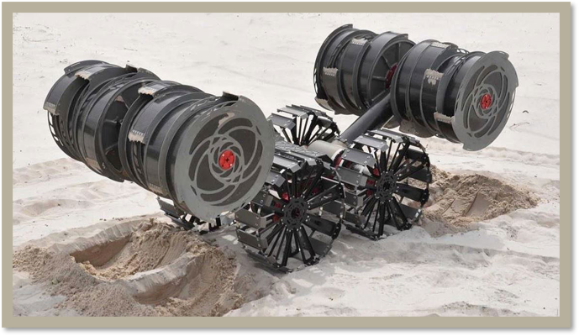
RE-RASSOR ARM
Team 505 | Grace Busch | Evaline Cantarero | Jackson Davis | David Nowicki
Objective
Redesign the shoulder and arm of an educational rover used to show mining and excavating techniques on other planets
Background
In Collaboration with Florida Space Institute and NASA the RE-RASSOR project was extended to FAMU-FSU College of Engineering.
The RE-RASSOR was developed by NASA to be a mining and excavating tool that is intended to collect materials for future construction and manufacturing on other planets
Future Work
Purchase Filament and Parts
3D Print
Test
Assemble
Initial Design
Stepper Motor
Nylon Gears
Carbon Fiber Arm​
Harmonic Gearbox​
Tapered Cylindrical Tube Arm
Specifications
Motion: Rotates 270 Degrees
Power: 12 V
Support: Lift 13 kg Drum
Shoulder Joint and Arm
4
2
3
Shoulder Blade
Shoulder Joint
Gear Box
Arm
Assumptions
Provided 12 Volts​
Used in earth environment​
Only needs to pivot
1
Current NASA RASSOR

